Slide 1


Anti-Bullying Week 2018
RESPECT
Supported by

Slide 2
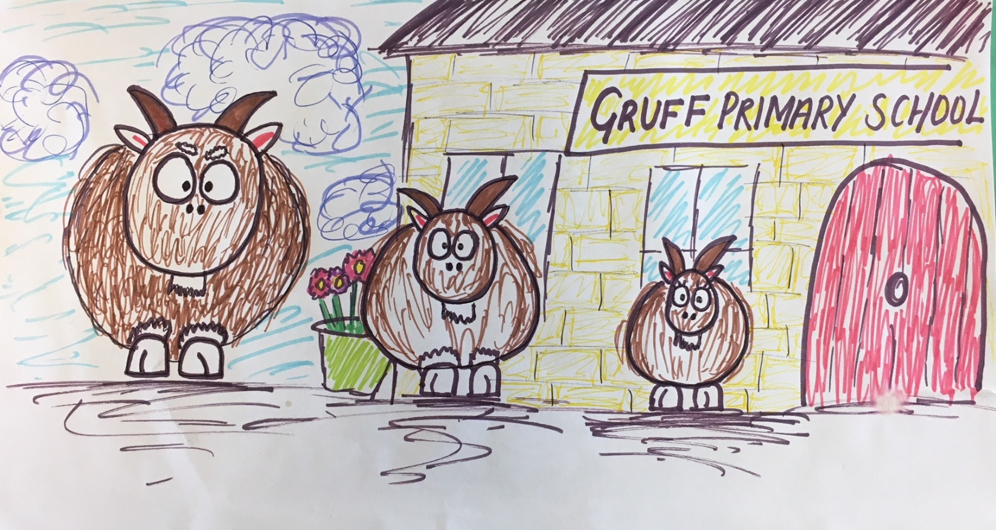
Three Bullying Goats Gruff
By Sarah Castles, Ashleigh Montgomery & Emma Lynch

Slide 3
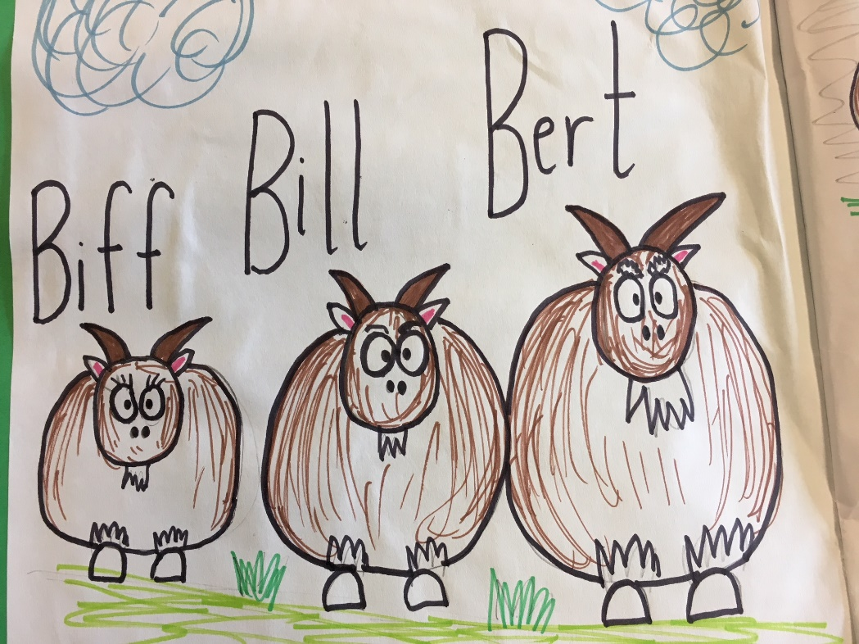
Once upon a time there were three billy goats.
The smallest was called Biff. The middle goat was called Bill. And the biggest goat was called Bert.

Slide 4
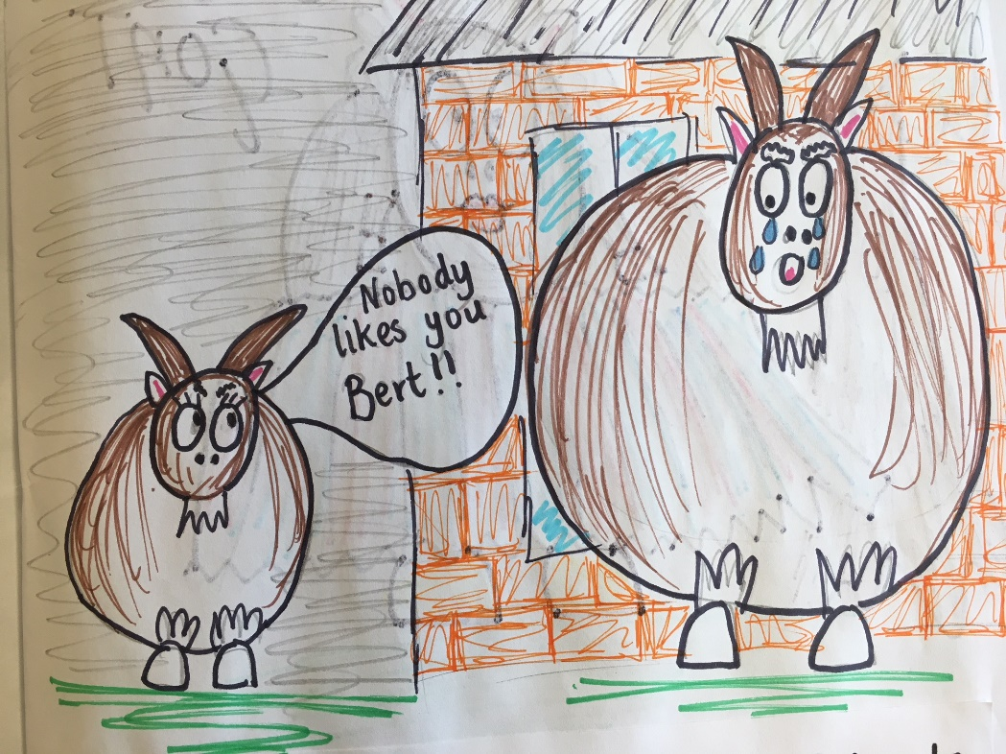
The three goats had been friends for many years.
But recently Biff, the smallest of the three goats, had been very mean and cruel. Especially to the biggest goat, Bert.

Slide 5
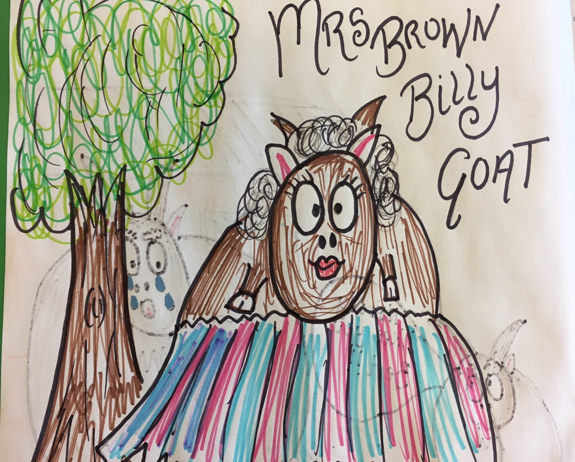
The goats used to play in the playground
together every day.
Mrs Brown Billy Goat was the teacher that looked after all the children at break and lunchtime.

Slide 6
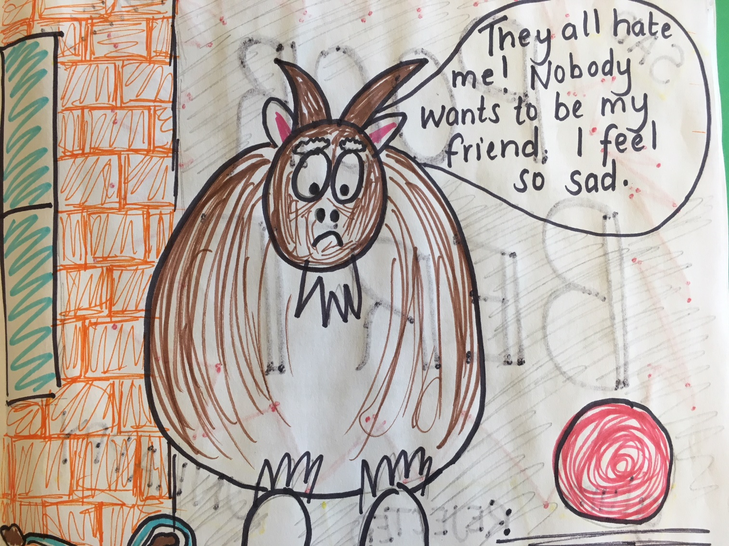
Mrs Brown Billy Goat had noticed that Bert,
the biggest Billy Goat, didn’t seem to be playing with his friends in the playground. He looked very sad. Mrs Brown Billy Goat decided she would find out if there was something wrong.

Slide 7
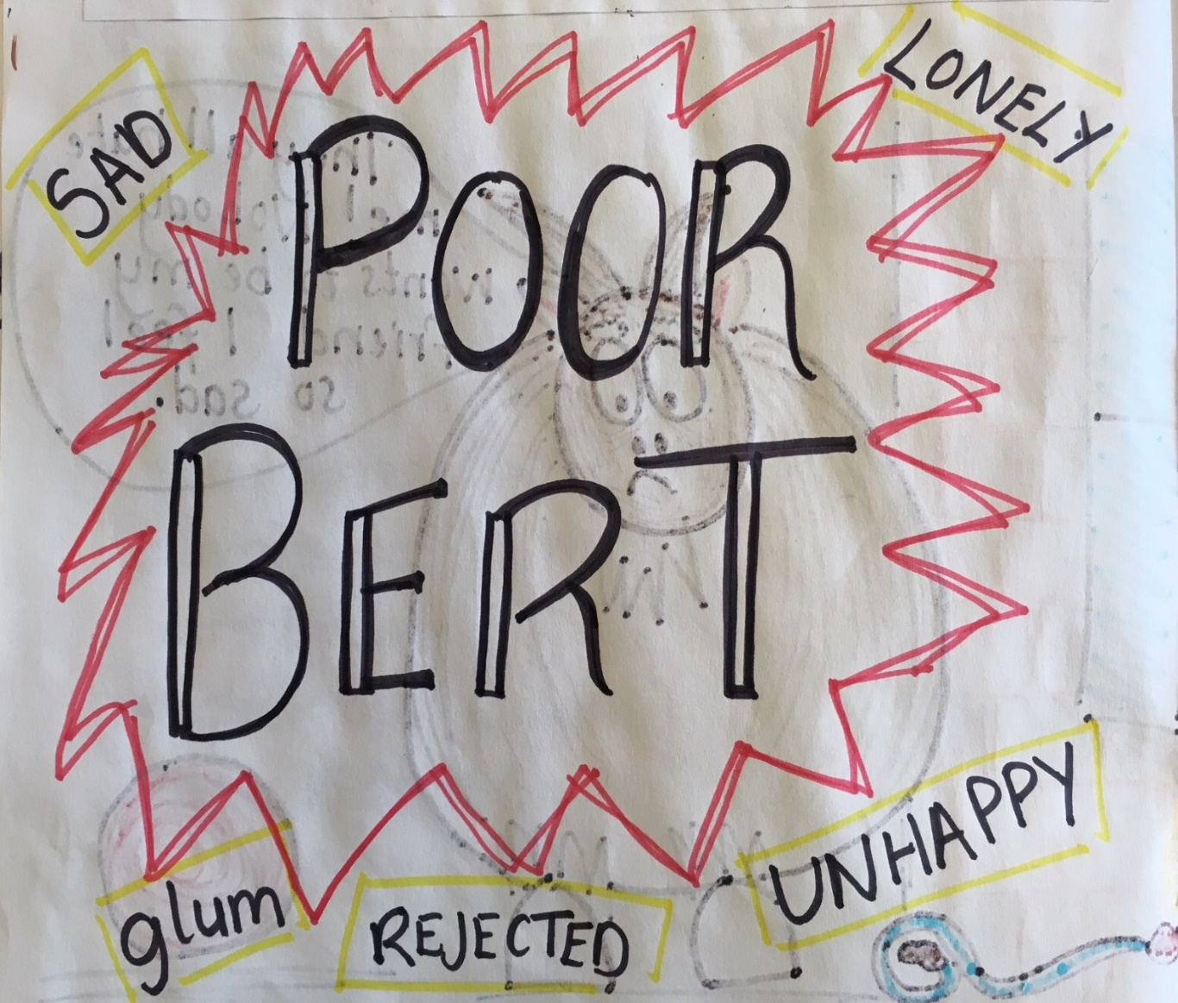
After speaking to him she finally got to the
bottom of it. Biff, the smallest Billy Goat, had been very unkind to Bert. He called him names, hit him when the teacher wasn’t looking and left him out of games. Poor Bert!

Slide 8
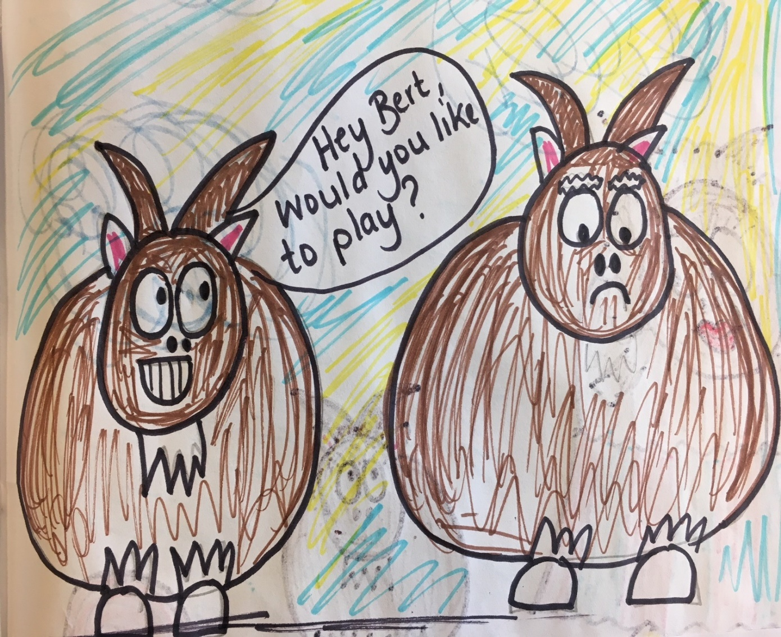
Billy Goat Bill had noticed this. So, he would
smile at Bert sometimes, to try and make him feel happy. And, if the others weren’t around, Bill would play with Bert. However, Bill would just watch and keep quiet when Biff and his friends gave Bert a hard time.

Slide 9
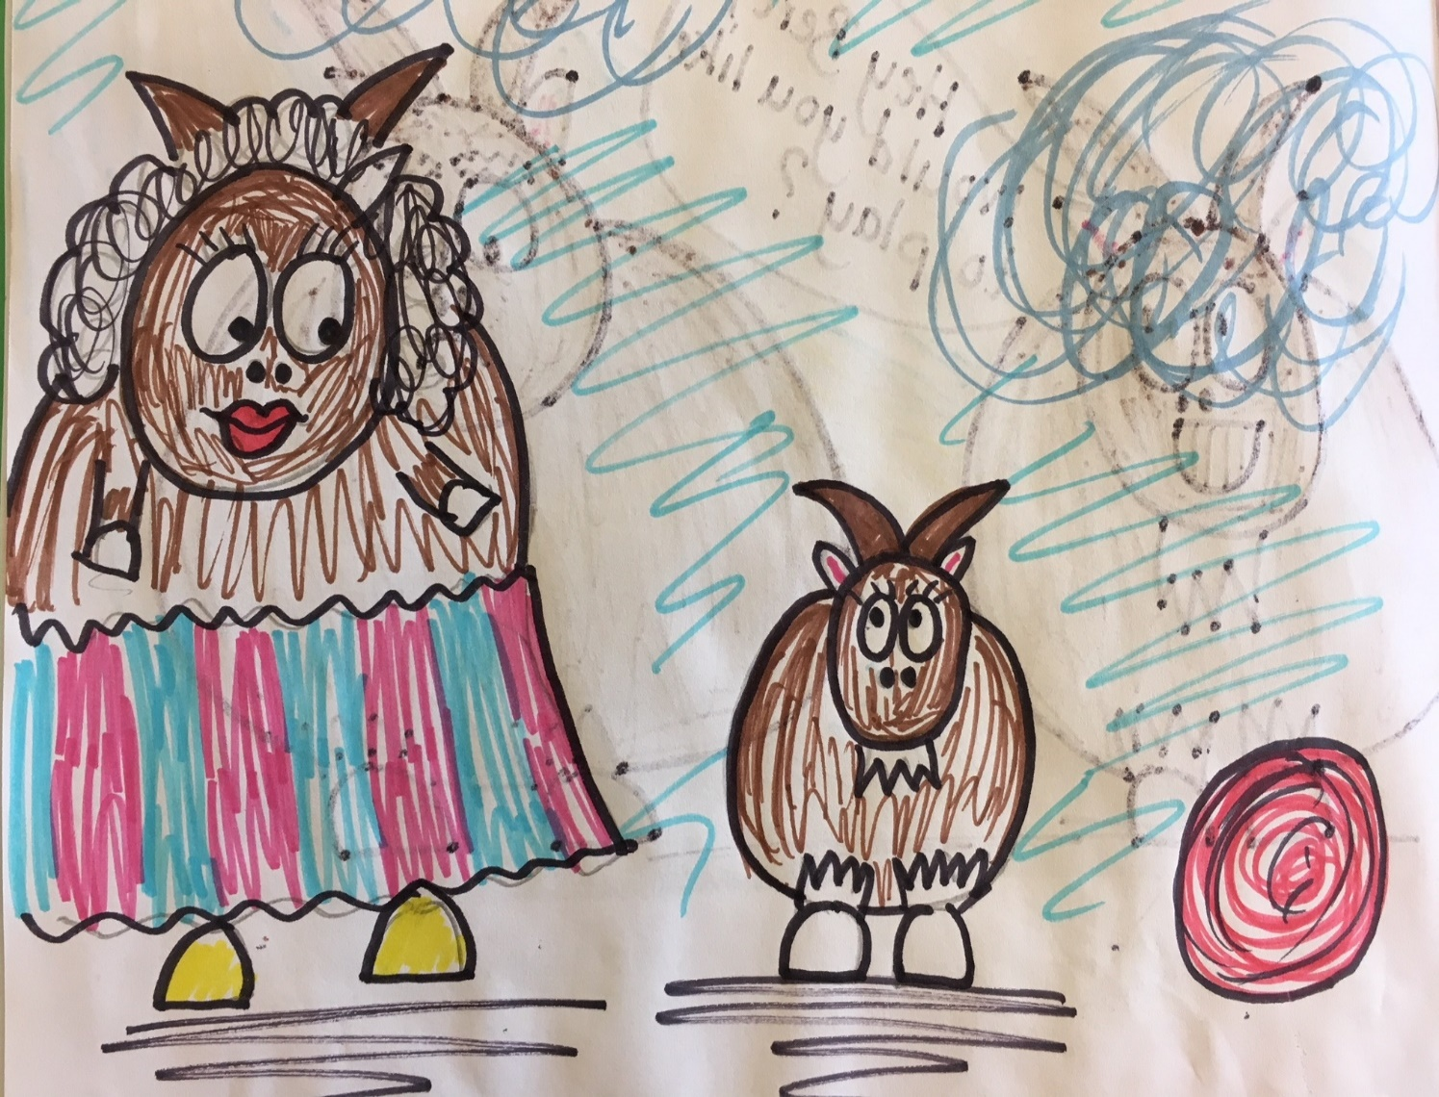
Mrs Brown Billy Goat stopped Biff, the smallest
billy goat, to ask him why Bert looked so sad.
“Do you know what’s wrong with Bert, Biff? Have you hurt him?” she said.

Slide 10
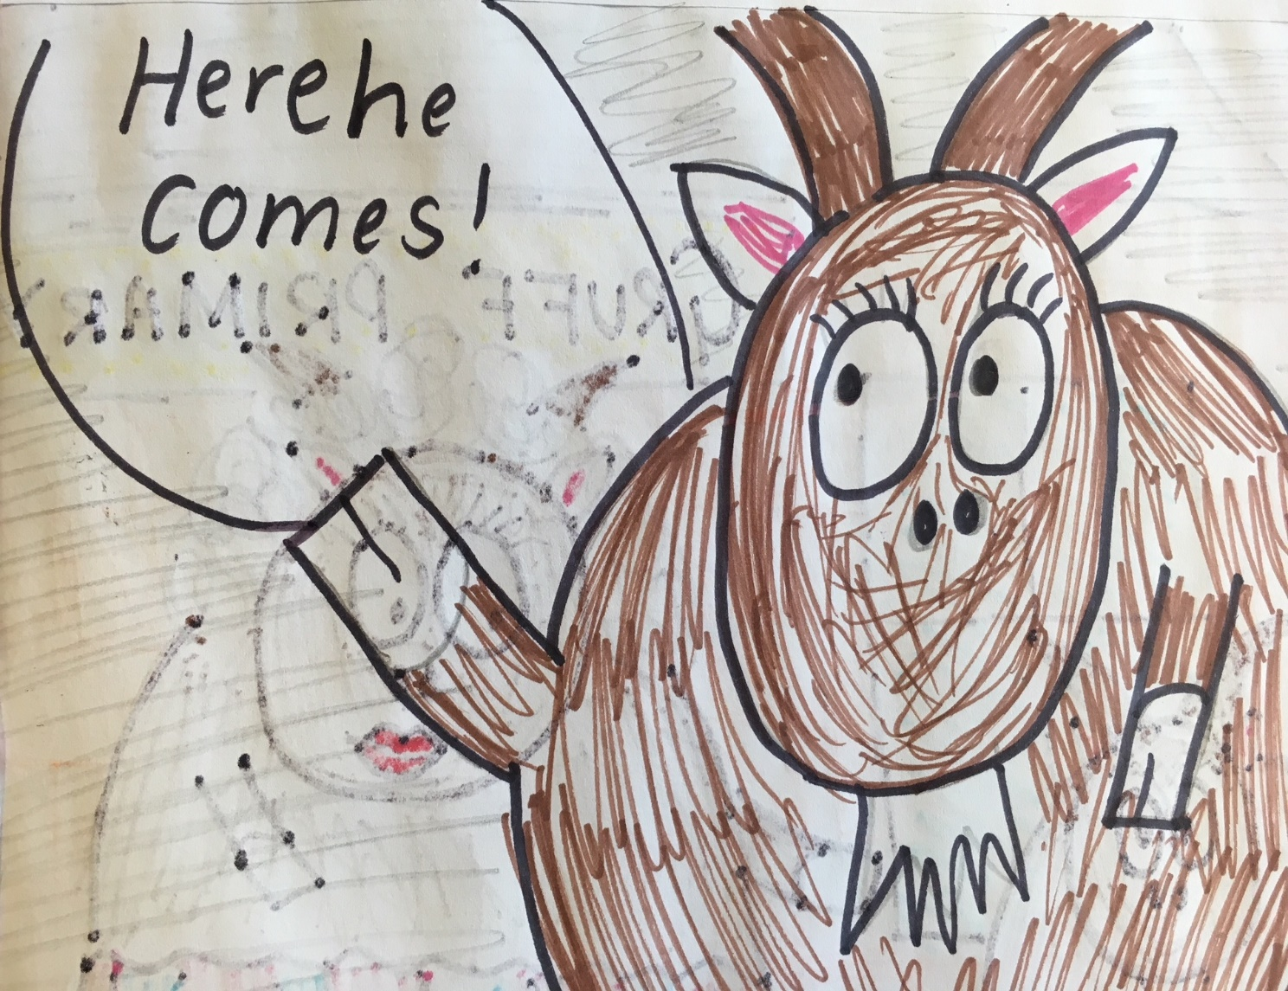
“Oh no, Mrs Brown. I’m too small to bully anyone!”
If anyone was to bully him, it would be Bill. He is a lot bigger than I am. Oh look, here he comes now!”
At that moment, Biff scampered off.

Slide 11
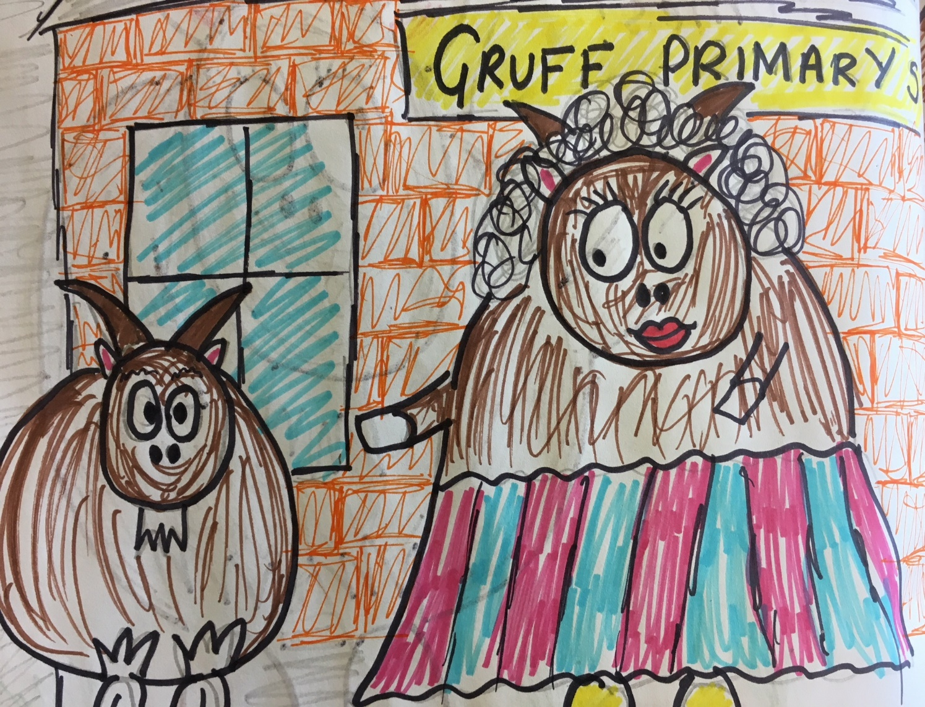
“Bill”, Mrs Brown called, as he skipped past.
“Yes, Mrs Brown?”, answered Bill.
“Do you know why Bert look so sad? Is someone being unkind to him?”, Mrs Brown asked.

Slide 12
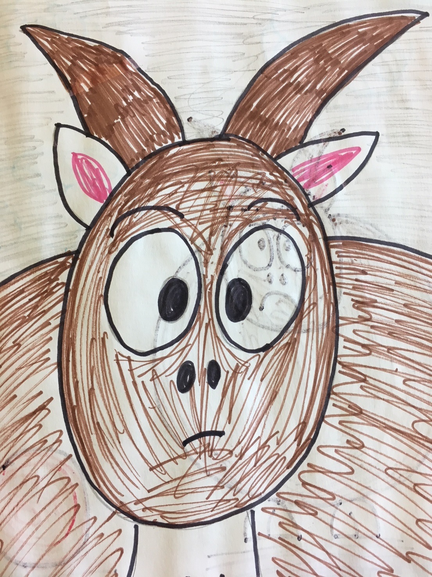
“Ermm, ahhh… No Mrs Brown” said Bill.
“I’ve got no idea why Bert may look so sad. Oh, they are starting a new game of catch. I better go!”

Slide 13
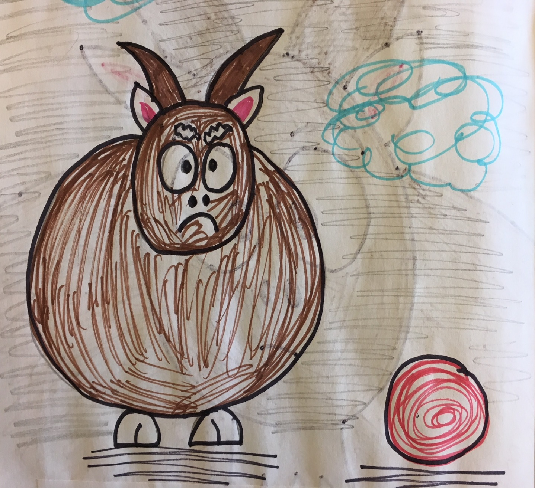
A few moments later, Bert walked past. Alone.
He looked very sad. He looked very lonely.
“Bert, my dear. Are you ok?” asked Mrs Brown.

Slide 14
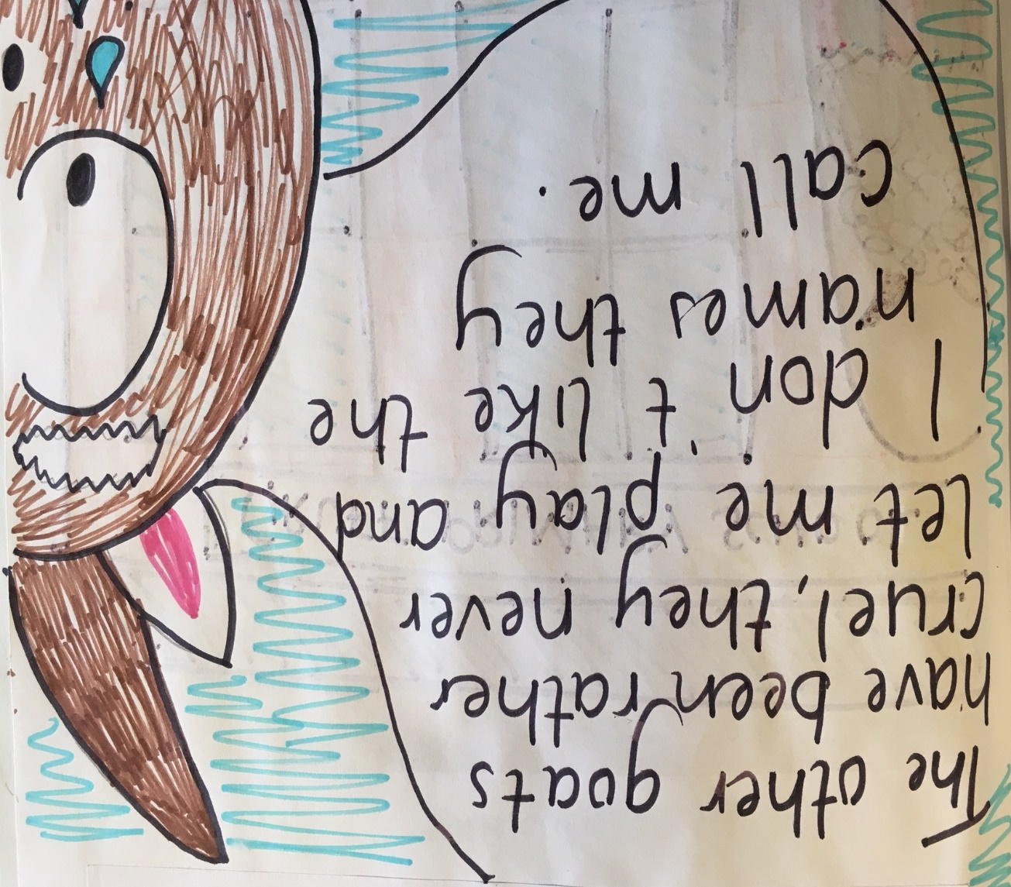
Bert stopped and looked at the ground.
Tears started to trickle down to his chin. He took a deep breath and said:

Slide 15
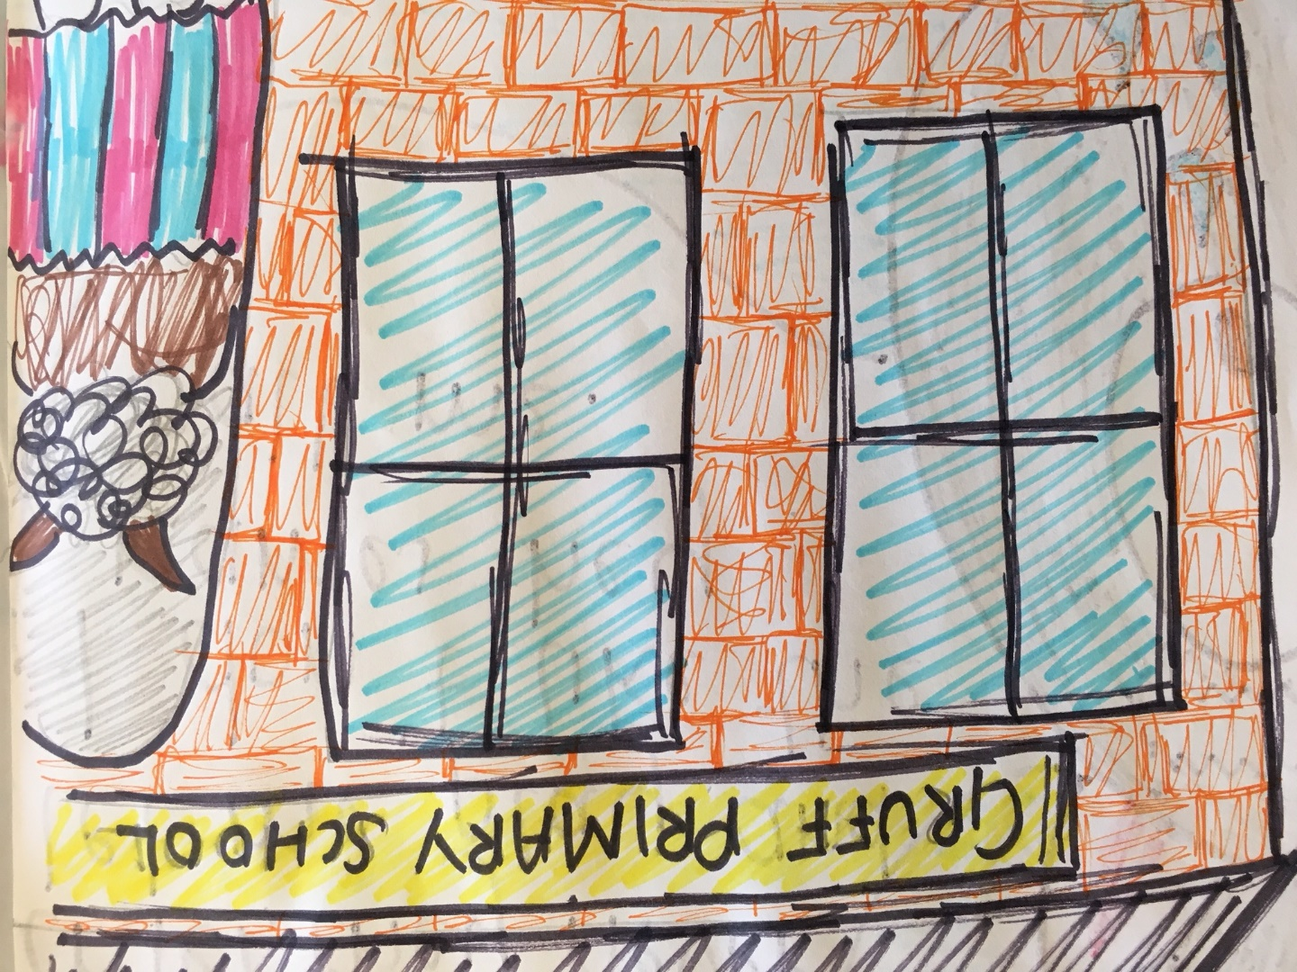
“Oh deary me,” said Mrs Brown Billy Goat.
“We will have to sort this out! Come with me and we will talk to your teacher.”
Mrs Brown took Bert’s hoof and led him in the direction of the school building.

Slide 16
What do you think will happen next?
Supported by

Slide 17
Mrs Brown Billy Goat spoke to Biff and to Bill.
She talked to them about RESPECT.
“We must RESPECT everybody. We must be careful not to hurt them, or to hurt their feelings.” she said.

Slide 18
“We don’t have to be friends with everybody.
But, we should show friendly behaviour to everyone we meet. Can you tell me some examples of friendly behaviour?”

Slide 19
So, while Biff and Bill and Bert weren’t friends,
they treated each other with respect. They used kind words, helped each other and made everyone feel welcome and happy.

Slide 20
Three Bullying Goats Gruff
The End

